Slide 1

COIS 3320: Fundamentals of Operating Systems
Alaadin Addas
Week 5
Concurrency, C Programming

Slide 2
Overview
Announcements/Reminders
Recap
Concurrency
Implementation of Semaphores
Monitors
Classic Synchronization Problems
Deadlock (Probably for Week 6)
A System Model for Deadlocks
Deadlock Detection
Dynamic/Static Deadlock Avoidance
C Programming
Functions
Strings in C
Arrays

Slide 3
Announcements/Reminders
I know you will all miss this lecture on Fridays, however, next week is Reading Week!
Lab 2 on the syllabus is due by tonight. However, it won’t be due until next Friday (during Reading Week) to give you some time to work on it.
Course Timeline:
Week 6 – Lecture content + midterm details.
Week 7 – Midterm.
The way things are going in terms of timing, I might have to dedicate the lab hours in some of the weeks that we don’t have a lab scheduled to cover content (poll).

Slide 4
Recap
When it comes to scheduling algorithms for real time processes, we discussed the Rate Monotonic (RM) and Earliest Deadline First (EDF) scheduling algorithms.
What are some of the drawbacks/advantages of the RM and EDF scheduling algorithms?
What is a semaphore?
What does the V(s) operation accomplish?
What does the P(s) operation accomplish?

Slide 5
Semaphore Implementation
Hardware support for synchronization
Most contemporary computer architectures (recall COIS 2300) offer hardware support for process synchronization in the form of specialized machine instructions.
The test-and-set instruction (TS) copies a variable into a register and sets the variable to zero in one indivisible machine cycle.
A lock is a synchronization barrier through which only one process can pass at a time.
By the way if any of you are confused by some of the textbook participation activities regarding the use of the term mutex don’t be!
A lock or a mutex is a synchronization primitive, in other words a mechanism that enforces limits on access to a resource when there are many threads or processes of execution.

Slide 6
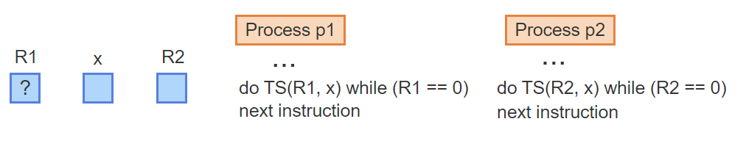
Locks Using TS – Visualized – 1
Two processes, p1 and p2, share a lock, implemented using a TS instruction on a shared variable x. R1 is a register of p1 and R2 is a register of p2

Slide 7
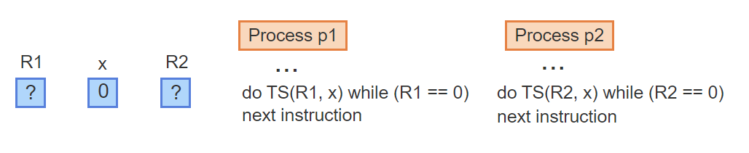
Locks Using TS – Visualized – 2
Initially, x = 0, implying that neither process may pass the lock. The initial values of R1 and R2 are irrelevant at this time

Slide 8
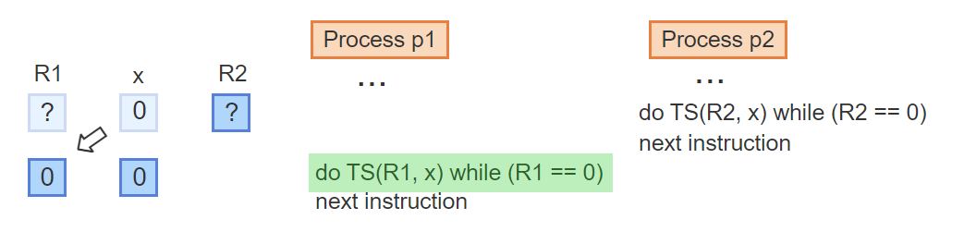
Locks Using TS – Visualized – 3
Process p1 executes TS, which copies x into R1 and sets x = 0. Since R1 remains 0, p1 continues executing the while-loop repeatedly

Slide 9
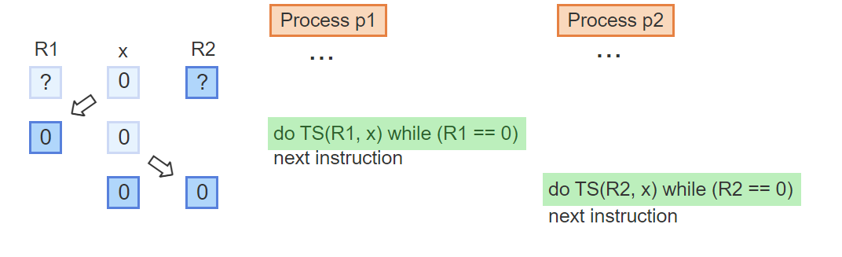
Locks Using TS – Visualized – 4
Similarly, the TS of p2 copies x into R2 and sets x = 0. Since R2 is 0, p2 also keeps executing the while-loop repeatedly

Slide 10
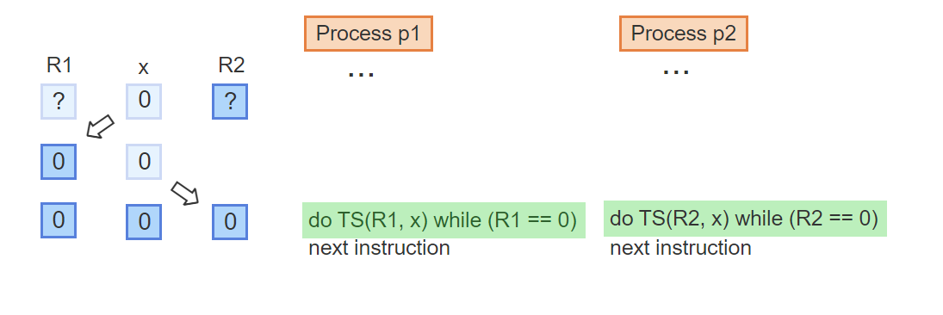
Locks Using TS – Visualized – 5
Both p1 and p2 are waiting inside the respective while-loops for the lock to open

Slide 11
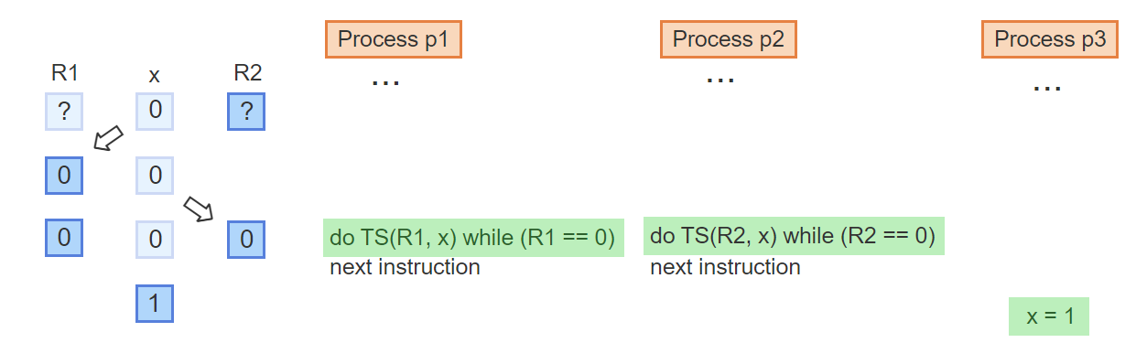
Locks Using TS – Visualized – 6
Later a third process p3 opens the lock by writing a 1 into x

Slide 12
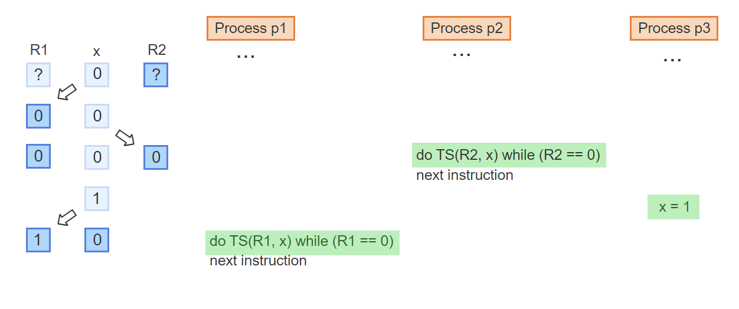
Locks Using TS – Visualized – 7
Whichever process reaches TS first, copies the 1 into the register and sets x back to 0, here p1 executed TS first

Slide 13
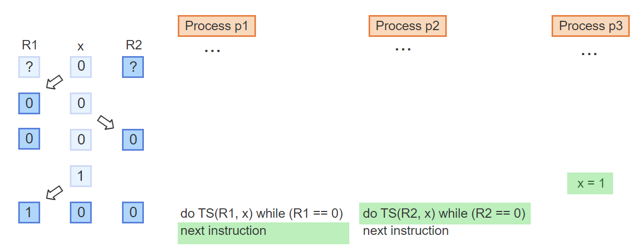
Locks Using TS – Visualized – 8
Since R1 = 1, process p1 passes the lock and continues with the next instruction while process p2 remains in the while-loop executing TS

Slide 14
Binary semaphores
Many synchronization problems do not require the full power of a general semaphore.
A binary semaphore can take only the values 0 or 1. Pb and Vb are the simplified P and V operations that manipulate binary semaphores. Pb and Vb on the binary semaphore sb can be implemented directly using the TS instruction:
Vb(sb): sb = 1
Pb(sb): do TS(R,sb) while R == 0
Busy-waiting is the act of repeatedly executing a loop while waiting for some condition to change.
Busy-waiting consumes CPU resources and should be avoided whenever possible. The implementation of Pb(sb) using TS is very simple but suffers from the drawback of busy-waiting.

Slide 15
Implementing P and V
A general semaphore s can be implemented using a regular integer variable manipulated by the functions P(s) and V(s). To guarantee that only one operation at a time can access and manipulate s, a binary semaphore is used.
The variable s serves a dual purpose:
When s is greater or equal 0, s represents the value of the semaphore.
Whenever s falls below 0, the value represents the number of processes blocked on the semaphore.
To avoid busy-waiting inside P(s) when s falls below 0, the process performs a blocking request, which places the process on a waiting list associated with s. A V(s) operation increments s and reactivates one process if one or more are blocked on s.

Slide 16
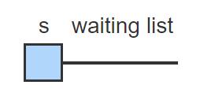
General Semaphores Visualization – 1
The implementation of P and V uses an integer s to represent the semaphore. A waiting list is associated with s, where blocked processes wait for s > 0

Slide 17
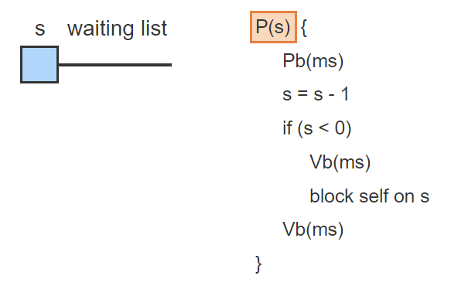
General Semaphores Visualization – 2
P(s) decrements s in a critical section implemented using the binary semaphore ms. If s < 0, the process blocks itself after releasing the critical section

Slide 18
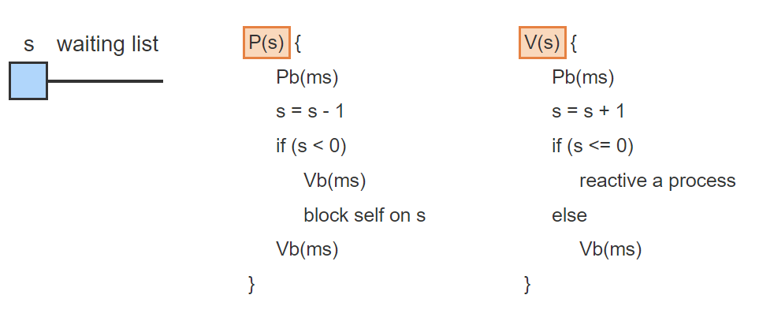
General Semaphores Visualization – 3
V(s) increments s in a critical section implemented using the same semaphore ms. If s <= 0 then one or more processes are blocked on s. One process is reactivated in the critical section

Slide 19
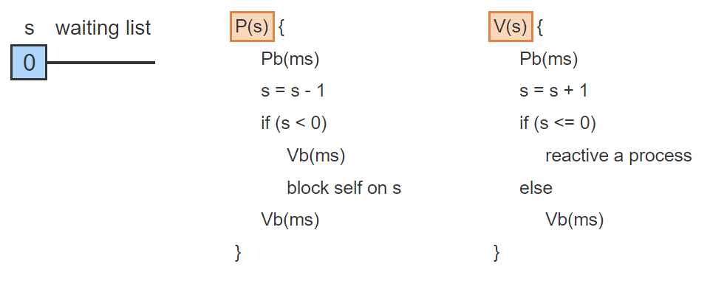
General Semaphores Visualization – 4
If s = 1 initially, a process p1 decrements s. Since s is not less than 0, the process completes the P operation and leaves

Slide 20
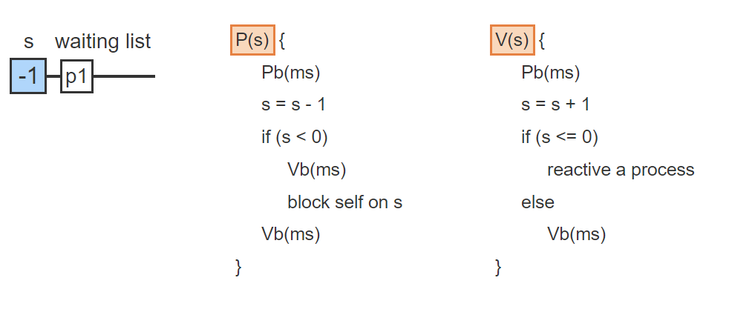
General Semaphores Visualization – 5
If p1 repeats the same P operation, s becomes -1, and the processes blocks itself on s. The value s = -1 indicates that 1 process is blocked

Slide 21
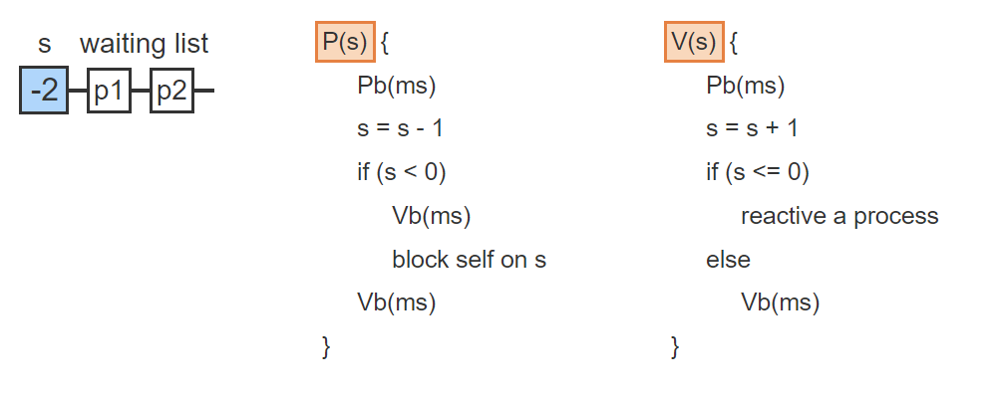
General Semaphores Visualization – 6
When another process, p2, tries to pass the P operation, s is again decremented & p2 becomes blocked on s. The value s = -2 indicates that 2 processes are blocked

Slide 22
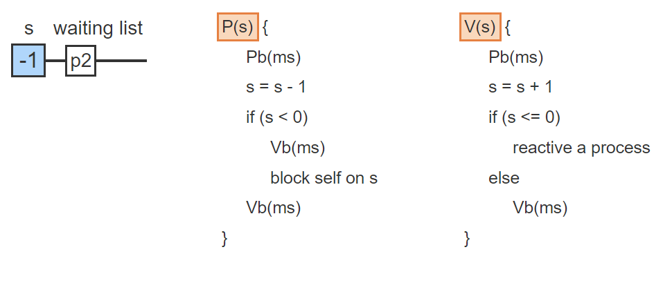
General Semaphores Visualization – 7
A subsequent V operation increments s. Since s <= 0, V reactivates p1 from the waiting list, which exits the critical section & continues executing

Slide 23
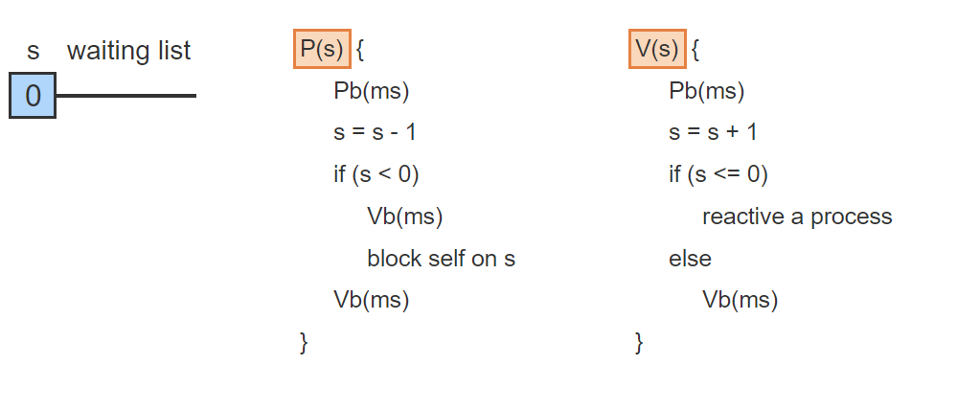
General Semaphores Visualization – 8
Another V(s) operation reactivates p2, leaving the waiting list empty and the semaphore equal to 0

Slide 24
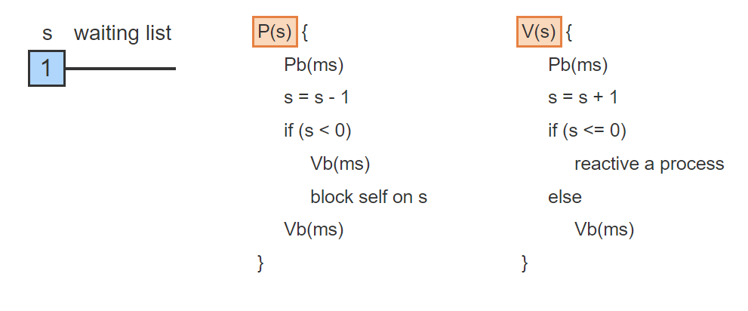
General Semaphores Visualization – 9
One more V(s) operation only increments s again, but no process is reactivated

Slide 25
Monitors
P and V operations on general semaphores are versatile primitives capable of solving a variety of synchronization problems.
However, P and V operations are low-level primitives that are prone to difficult-to-diagnose programming errors.
Solution? Monitors!
A monitor is a high-level synchronization primitive implemented using P and V operations. Following the principles of abstract data types, a monitor encapsulates data along with functions through which the data may be accessed and manipulated.
A condition variable is a named queue on which processes can wait for some condition to become true.

Slide 26
Monitor Implementation Rules
Any implementation of a monitor must:
Guarantee that the functions are mutually exclusive. Thus only one process at a time may be executing inside a monitor.
Provide condition variables such that a process can step outside of the monitor while waiting for a condition and thus not prevent other processes from entering the monitor.
A condition variable c is accessed using two special operations:
c.wait causes the executing process to block and be placed on a waiting queue associated with the condition variable c.
c.signal reactivates the process at the head of the queue associated with the condition variable c.
Memorize c.wait and c.signal!

Slide 27
Classic Synchronization Problems
The readers-writers problem:
The readers-writers problem is an extension of the critical section problem where two types of processes, readers and writers, compete for access to a common resource. Readers are allowed to enter the critical section (CS) concurrently but only one writer is allowed to enter at a time.
The main challenge is to guarantee maximum concurrency of readers while preventing the starvation of either type of process. Specifically, two rules must be enforced:
A reader is permitted to join other readers currently in the CS only when no writer is waiting. When the last readers exits the CS, the writer is allowed to enter.
All readers that have arrived while a writer is in the CS must be allowed to enter before the next writer.
Rule 1 guarantees that writers cannot starve. Rule 2 guarantees that readers cannot starve. Jointly the two rules guarantee maximum concurrency of readers.

Slide 28
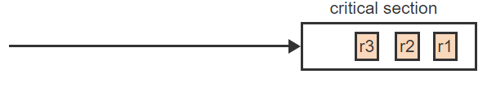
Readers/Writers Problem Visualized – 1
Three readers arrive at the CS. Since the CS is empty, all three are allowed to enter (Rule 1)

Slide 29
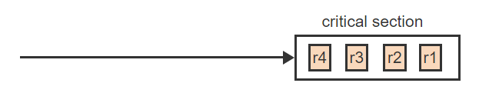
Readers/Writers Problem Visualized – 2
A fourth reader arrives. Since no writer is waiting, r4 is allowed to join the other readers (Rule 1 Again)

Slide 30
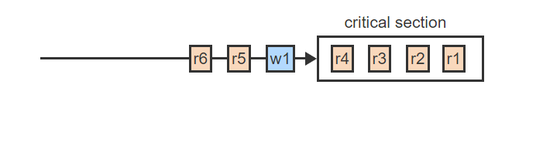
Readers/Writers Problem Visualized – 3
When a writer arrives, no more readers are allowed to enter (Rule 1)

Slide 31
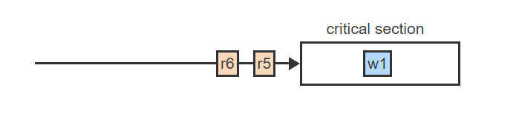
Readers/Writers Problem Visualized – 4
When the last reader leaves, w1 is allowed to enter (Rule 1)

Slide 32
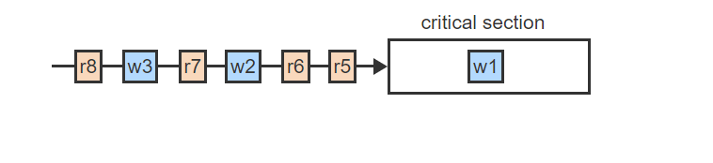
Readers/Writers Problem Visualized – 5
While w1 is in CS, other readers and writers may arrive

Slide 33
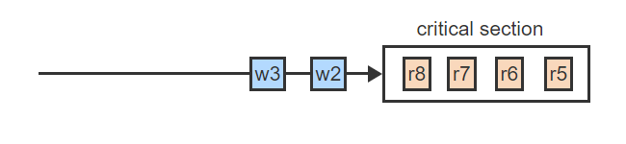
Readers/Writers Problem Visualized – 6
When w1 leaves, all readers, including those arriving after w2 and w3, are allowed to enter (Rule 2)

Slide 34
The Dining-Philosophers Problem
The dining-philosophers problem is representative of situations where multiple processes compete for shared resources but each process needs more than one resource at a time.
Five "philosophers", each representing a concurrent process, are seated around a table. Five "forks", each representing a resource, are placed on the table such that each two neighboring philosophers share one fork. Each philosopher alternates asynchronously between a phase of "thinking", which represents execution not requiring any shared resources, and "eating", which requires the prior acquisition of the two forks adjacent to the philosopher and shared with the two respective neighbors.
The main challenge is to prevent deadlock while guaranteeing that any two nonadjacent philosophers can always eat concurrently.
Well this makes no sense, where are the pictures?

Slide 35
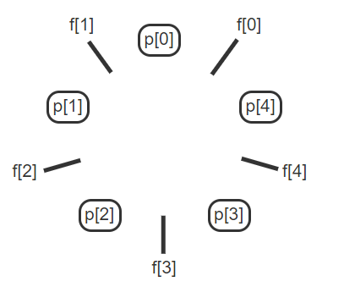
DPP Problem – Visualized – 1
Five philosophers, p[i], sit in a circle. Each p[i] has a left fork, f[i], and a right fork, f[i+1 mod 5]. Initially, all p[i]'s are thinking, which requires no resources

Slide 36
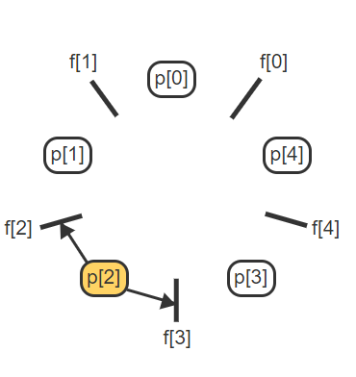
DPP Problem – Visualized – 2
In order to eat, a philosopher needs to request both the left and the right fork. Ex: p[2] needs to request f[2] and f[3] to eat

Slide 37
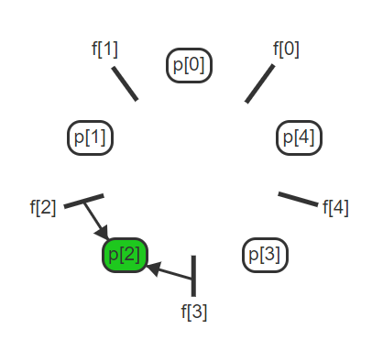
DPP Problem – Visualized – 3
If both forks are available, p[i] picks up the forks and starts eating

Slide 38
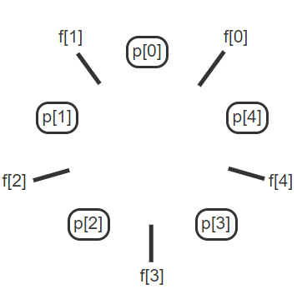
DPP Problem – Visualized – 4
When finished eating, p[i] puts down both forks and enters again the phase of thinking

Slide 39
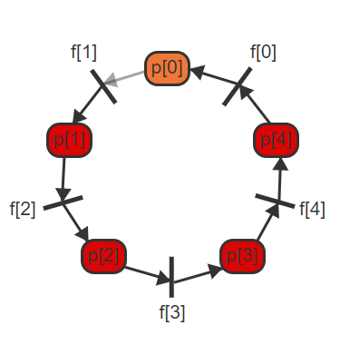
DPP Problem – Visualized – 5
To prevent deadlock, a situation where each p[i] picks up one fork and is requesting the second must be avoided, since all p[i]s would be blocked forever

Slide 40
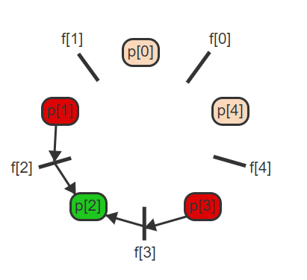
DPP Problem – Visualized – 6
When one philosopher is eating, the two immediate neighbors are blocked because each needs one of the shared forks. Ex: p[2] is holding f[2] and f[3], which blocks p[1] and p[3]

Slide 41
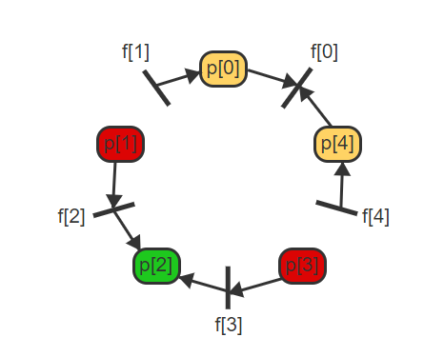
DPP Problem – Visualized – 7
But the solution must guarantee that either p[0] or p[4] can eat concurrently with p[2], depending on which philosopher grabs the shared fork f[0] first

Slide 42
Preventing Deadlock
The behavior of each philosopher p[i] can be represented as a loop that alternates between the phases of thinking and eating.
Prior to eating, p[i] requests the two adjacent forks and returns the forks when finished eating.
The forks can be represented as 5 semaphores, f[0] through f[4], all initialized to 1.
P(f[i]) then corresponds to picking up fork f[i] and V(f[i]) corresponds to putting down fork f[i].

Slide 43

Preventing Deadlock
This code leads to deadlock since all philosophers can pick up the left fork f[i] concurrently and then block indefinitely on picking up the right fork. Several approaches exist to avoid the problem.
p(i) {
while (1) {
think
P(f[i])
P(f[i+1 mod 5])
eat
V(f[i])
V(f[i+1 mod 5])
}
}

Slide 44
Preventing Deadlock – Approaches
Approach 1: Request both forks at the same time in a critical section.
Approach 2: One philosopher picks up the forks in the opposite order from all other philosophers.
Some work for you:
For a 1% bonus write a one page solution to the DPP, you may consult the textbook, or any other source on the internet.
Diagrams are certainly welcome.
Message it to me on MS Teams privately.
The bonus mark is only available to those in attendance.

Slide 45
Semaphores
Semaphores are general-purpose primitives that allow solving a variety of synchronization problems in a systematic manner.
A semaphore s is a non-negative integer variable that can be accessed using only two special operations, P and V.
V(s): increment s by 1
P(s): if s > 0, decrement s by 1, otherwise wait until s > 0
The implementation of P and V must guarantee that:
If several processes simultaneously invoke P(s) or V(s), the operations will occur sequentially in some arbitrary order.
If more than one process is waiting inside P(s) for s to become > 0 , one of the waiting processes is selected arbitrarily to complete the P(s) operation.

Slide 46

Onto C Programming!

Slide 47
Functions in C
A few things to note about functions in C:
All parameters are passed by value!
Variables declared within a function are method local variables (e.g., cannot be seen outside the function).
Placement of functions
Large programs:
Manage related function in a .c file.
Write a .h file containing all the prototypes of the functions.
#include the header file in the files that uses the functions.
Small Programs:
Place your functions in the same .c file, preferably in the following order:
All prototypes
main() function
Other functions

Slide 48
Function Prototype in C
A function prototype is simply the declaration of a function that specifies function's name, parameters and return type. It doesn't contain function body.
If you define the function body at the beginning of your program you don’t need to use a prototype.

Slide 49
//One way to do things.
#include <stdio.h>
int addNumbers(int a, int b); // function prototype
int main()
{
int n1,n2,sum;
printf("Enters two numbers: ");
scanf("%d %d",&n1,&n2);
sum = addNumbers(n1, n2); // function call
printf("sum = %d",sum);
return 0;
}
int addNumbers(int a, int b) // function definition
{
int result;
result = a+b;
return result; // return statement
}

Slide 50
//Another way to do things.
#include <stdio.h>
//addNumbers is declared and defined at the top, hence no need for a prototype.
int addNumbers(int a, int b) // function definition
{
int result;
result = a+b;
return result; // return statement
}
int main()
{
int n1,n2,sum;
printf("Enters two numbers: ");
scanf("%d %d",&n1,&n2);
sum = addNumbers(n1, n2); // function call
printf("sum = %d",sum);
return 0;
}

Slide 51
Strings in C
Strings in C are simply arrays of characters.
For example:
char s[10];
This is a ten (10) element array that can hold a character string consisting of ≤ 9 characters.
This is because C does not know where the end of an array is at run time.
By convention, C uses a NULL character '\0' to terminate all strings in its library functions
For example:
char str [10] = {'u', 'n', 'I', 'x', '\0’};
It’s the string terminator (not the size of the array) that determines the length of the string.

Slide 52
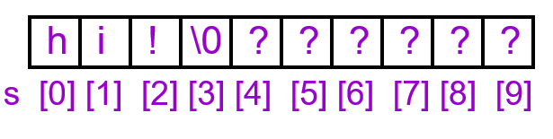
Accessing Individual Characters
The first element of any array in C is at index 0. The second is at index 1, and so on ...
char s[10];
s[0] = 'h';
s[1] = 'i’;
s[2] = '!';
s[3] = '\0’;
This notation can be used in all kinds of statements and expressions in C:
c = s[1];
if (s[0] == '-') …
switch (s[1]) ...

Slide 53
String Literals
String literals are given as a string quoted by double quotes.
printf("Long long ago.");
Initializing char array ...
char s[10]="unix"; /* s[4] is '\0'; */
char s[ ]="unix"; /* s has five elements */

Slide 54
Printing Strings with Printf()
Example:
char str[ ] = "A message to display";
printf ("%s\n", str);
printf expects to receive a string as an additional parameter when it sees %s in the format string.
Can be from a character array.
Can be another literal string.
Can be from a character pointer (more on this later).
printf knows how much to print out because of the NULL character at the end of all strings

Slide 55
Example
char str[10]="unix and c";
printf("%s", str);
printf("\n");
str[6]='\0';
printf("%s", str);
printf("\n");
printf("\n");
printf(str);
printf("\n");
str[2]='%';
printf(str);
printf("\n");

Slide 56
More Work
Research:
Printing with the puts() function.
String input with the gets() function.
Lastly, inputting strings with the scanf function
Play around with it and have fun.
Did you take the string datatype for granted before?

Slide 57
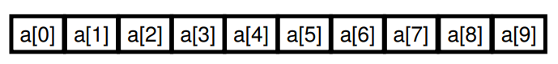
Arrays in C
Single-Dimensional Arrays:
Generic declaration:
typename variablename[size]
typename is any type
variablename is any legal variable name
size is a number the compiler can figure out
For Example: int a[10];
Defines an array of ints with subscripts ranging from 0 to 9
There are 10*sizeof(int) bytes of memory reserved for this array.
You can use a[0]=10; x=a[2]; a[3]=a[2]; etc…
You can use scanf("%d",&a[3]);

Slide 58
Constants → Arrays
It is useful to define arrays using constants:
#define MONTHS 12 //defining constant in C
int array [MONTHS]; //using constant to create array.
However, in ANSI C, you cannot:
int n;
scanf(“%d”, &n);
int array[n];
In GNU C, the variable length array is allowed.
In ANSI C, the handling of variable length array is more complicated.

Slide 59
Array-Bounds Checking
C, unlike many languages, does NOT check array bounds subscripts during:
Compilation (some C compilers will check literals)
Runtime (bounds are never checked)
If you access off the ends of any array, it will calculate the address it expects the data to be at, and then attempts to use it anyways
You may get “something…”
OR you may get a memory exception (segmentation fault, bus error, core dump error).
It is the programmer’s responsibility to ensure that their programs are correctly written and debugged!
This does have some advantages but it does give you all the rope you need to hang yourself!

Slide 60
Initializing Arrays
Initialization of arrays can be done by a comma separated list following its definition:
array [4] = { 100, 200, 300, 400 };
The line of code above is just like:
int array [4];
array[0] = 100;
array[1] = 200;
array[2] = 300;
array[3] = 400;
Alternatively, you can let the compiler figure out the size:
int array[] = { 100, 200, 300, 400}; //The size is 4 here but we did not input it the compiler is smart enough to figure it out.

Slide 61
Simple Array Example
#include <stdio.h>
int main() {
float expenses[12]={10.3, 9, 7.5, 4.3, 10.5, 7.5, 7.5, 8, 9.9, 10.2, 11.5, 7.8};
int count,month;
float total;
for (month=0, total=0.0; month < 12; month++) {
total+=expenses[month];
}
for (count=0; count < 12; count++) {
printf ("Month %d = %.2f K$\n", count+1, expenses[count]);
printf("Total = %.2f K$, Average = %.2f K$\n", total, total/12);
}
return 0;
}

Slide 62
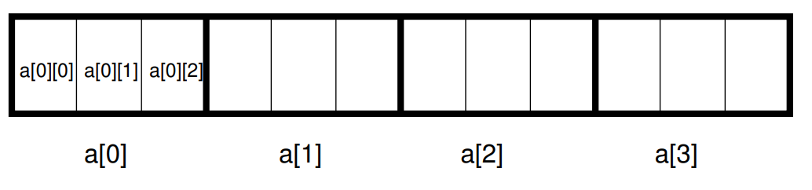
Multidimensional Arrays
Arrays in C can have virtually as many dimensions as you want.
Definition is accomplished by adding additional subscripts when it is defined.
For example:
int a [4] [3] ;
Defines a two dimensional array
a is an array of int[3];
In memory it looks like this:

Slide 63
Initializing Multidimensional Arrays
int a[4] [3] = { 1, 2, 3, 4, 5, 6, 7, 8, 9, 10, 11, 12 };
This is Equivalent to:
a[0][0] = 1;
a[0][1] = 2;
a[0][2] = 3;
a[1][0] = 4;
... a[3][2] = 12;

Slide 64
Initializing Multidimensional Arrays Example
#include <stdio.h>
#include <stdlib.h>
int main () {
int random1[8][8];
int a, b;
for (a = 0; a < 8; a++){
for (b = 0; b < 8; b++){
random1[a][b] = rand()%2;
for (a = 0; a < 8; a++){
for (b = 0; b < 8; b++){
printf ("%c " , random1[a][b] ? 'x' : 'o’);
printf("\n");
}
}
}
}
return 0;
}

Slide 65
Arrays as Function Parameters
In the following program, the array addresses (i.e., the values of the array names), are passed to the function inc_array().
This does not conflict with the rule that states “parameters are passed by values”

Slide 66
Arrays as Function Parameters Example
main()
{
int test[3]={1,2,3};
int ary[4]={1,2,3,4};
int i;
inc_array(test,3);
for(i=0;i<3;i++){
printf("%d\n",test[i]);
inc_array(ary,4);
for(i=0;i<4;i++){
printf("%d\n",ary[i]);
}
}
return 0;
}
void inc_array(int a[ ], int size)
{
int i;
for(i=0;i<size;i++){
a[i]++;
}
}

Slide 67
Sorting Example
void mysort(int a[ ],int size)
{
int i,j,x;
for(i=0; i<size; i++){
for(j=i; j>0; j--){
if(a[ j ] < a[ j-1]){
/* Change the order of a[ j ] and a[ j-1] */
x=a[ j ];a[ j ]=a[ j-1]; a[j-1]=x;
}
}
}
}

Slide 68
Using MySort
int main()
{
int i;
int tab[10] = {3,6,3,5,9,2,4,5,6,0};
for(i=0;i<10;i++){
printf("%d ",tab[i]);
printf("\n");
mysort(tab,10);
for(i=0;i<10;i++){
printf("%d ",tab[i]);
printf("\n");
}
}
return 0;
}

Slide 69
Onto Lab 2

